Slide 1
Office of the National Rural Health Commissioner
Rural Generalist Recognition
National Rural Health Commissioner
Adj. Prof. Ruth Stewart
Monday, 20 November 2023
Notes:
Date of event: Mon 6 Nov 2023
Event location: via Zoom
Presentation theme: Public consultation on RG recognition
Time allocation and breakdown: 19:00-20:30 (AEST)

Slide 2
Acknowledgment of Country
I acknowledge the Traditional Custodians of the land, the Wurundjeri and Bunurong people, on which I am meeting you from today.
I pay my respects to the Elders of this land and waterways, ancestors who have come before us and those who are with us and guide us today.
I would also like to acknowledge emerging leaders within our communities.
I extend my respect to all Aboriginal and Torres Strait Islander people here today.
Notes:
I’d also like to acknowledge the Aboriginal and Torres Strait Islander professionals here today – may your achievements in your field be celebrated and provide continued inspiration for young health workers and medical students.
The original inhabitants of the Maranoa Regional Council area were predominantly the Mandandanji and Gunggari Aboriginal people, <https://www.maranoa.qld.gov.au/downloads/file/938/annual-report-2019-19-part-1-our-region>.

Slide 3
What is a Rural Generalist?
Notes:
People living in rural and remote Australia receive $850 per capita per year in government health funding
This translates to $6.55b annual shortfall in spending on healthcare for these people (relative to that spent on people in major cities)
This reflects the fact that they receive fewer services than people in cities
Note: Specialist services figures source: AIHW. (2021). Medicare-subsidised GP, allied health and specialist health care across local areas: 2019–20 to 2020–21.
Note: 60% of rural hospitals do not have any FACEMS - Emergency physicians workforce figures source: ACEM Annual Census Report 2021

Slide 4
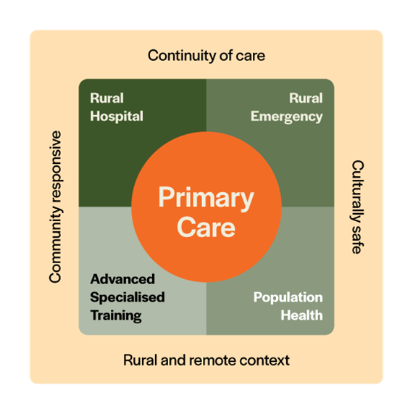
What is a Rural Generalist?
A medical practitioner who is trained to meet the specific current and future healthcare needs of Australian rural and remote communities, in cost-effective way, by providing both comprehensive general practice and emergency care and required components of other medical specialty care in a hospital land community settings as part of a rural healthcare team.
The Collingrove Agreement
Notes:
RUTH TO TALK TO
Reference:
The Collingrove Agreement, <https://www.acrrm.org.au/rsrc/documents/misc/the-collingrove-agreement.pdf>

Slide 5
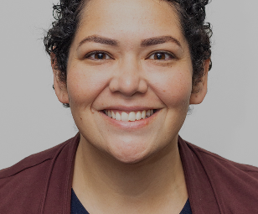
Dr Regina Waterhouse, RG Obstetrician, Joyce Palmer Health Service, Palm Island, Queensland
“Mostly I’ve never been able to contain my interest to just one area of medicine and thinking about systems in isolation without consideration of the whole has never made much sense to me. Rural Generalists look at the whole, not just the flavour of the day.
They not only consider all the health issues a person has, they put it into context of what is happening in that person’s life, family and community. That and they have mad skills... when your colleague says ‘you’ll just have to MacGyver it’ you know you’ve found your tribe.”

Slide 6
Dr Anthony Rengel
RG Geraldton, WA
"It really is so varied. I could start the week running a small clinic at a nursing post and end it working in the emergency department and anything can walk in the door there. On the weekend, I am flying to Shark Bay to the mine site and doing the medicals for the families there.

Slide 7
What does specialist recognition mean?
Notes:
People living in rural and remote Australia receive $850 per capita per year in government health funding
This translates to $6.55b annual shortfall in spending on healthcare for these people (relative to that spent on people in major cities)
This reflects the fact that they receive fewer services than people in cities
Note: Specialist services figures source: AIHW. (2021). Medicare-subsidised GP, allied health and specialist health care across local areas: 2019–20 to 2020–21.
Note: 60% of rural hospitals do not have any FACEMS - Emergency physicians workforce figures source: ACEM Annual Census Report 2021

Slide 8
Rural Generalist Specialist field
Rural generalist medicine, Specialist RG
Source: MBA, June 2018 https://www.medicalboard.gov.au/Registration-Standards.aspx
Notes:
RUTH TO TALK TO
Specialist field created under the National and added to the approved specialties list
AMC to accredit Fellowships as qualifications in specialist field (i.e. FACRRM and FRACGP-RG)
RGM is field within GP. Expected doctors with accredited qualification in this field would be both registered as specialist GP and RG
Doctors awarded approved qualification in the specialist field can apply for specialist registration. This is recorded in the register and they can use the title.

Slide 9
How will Rural Generalist Recognition help?
Named job
Aspirational rural career for doctors of future
Rural patients know their doctors’ skillset
Offers viable career option for doctors wanting to go rural but interested in specialist care
Workforce planning
Rural services planning build-in RG options
RG job portability across States/Territories
Professional excellence
RG profession inspires, trains, and mentors, new generation
Recognition of extra years of training and extra clinical responsibilities

Slide 10
How do Rural Generalists benefit communities?
Notes:
People living in rural and remote Australia receive $850 per capita per year in government health funding
This translates to $6.55b annual shortfall in spending on healthcare for these people (relative to that spent on people in major cities)
This reflects the fact that they receive fewer services than people in cities
Note: Specialist services figures source: AIHW. (2021). Medicare-subsidised GP, allied health and specialist health care across local areas: 2019–20 to 2020–21.
Note: 60% of rural hospitals do not have any FACEMS - Emergency physicians workforce figures source: ACEM Annual Census Report 2021

Slide 11
How do Rural Generalists benefit Communities?
Rural access to specialised services
25% fewer specialist services received by people in rural areas, than people in cities
60% fewer specialist services received by people in remote areas, than people in cities
Without local RGs, rural families bear costs of accessing urban care
RGs
enable care on-country
know local context
Rural access to emergency care
Most rural hospitals do not have any specialist emergency physicians
RGs:
Provide rural emergency care inc. obstetrics, anaesthetics and retrievals
Manage rural hospital emergency depts
Support local emergency rosters
Integrated rural care
Rural patients can receive coordinated care from community/ACCHS clinic to hospital and back
RGs:
RGs have the range of skills to pivot to fill local service gaps
RGs diverse skills can make other local health services viable
All RGs trained for GP and generalist care
Notes:
ACCESS to Services:
People living in rural and remote Australia receive $850 per capita per year LESS in government health funding than people in major citites
This translates to $6.55b annual shortfall in spending on healthcare for these people (relative to that spent on people in major cities)
This reflects the fact that they receive fewer medical services than people in cities i.e. fewer GP, and far fewer specialist (25% fewer specialists services in rural, 60% fewer specialist services in remote)
Note: Specialist services figures source: AIHW. (2021). Medicare-subsidised GP, allied health and specialist health care across local areas: 2019–20 to 2020–21.
Note: 60% of rural hospitals do not have any FACEMS - Emergency physicians workforce figures source: ACEM Annual Census Report 2021
ATRACTING RURAL DOCTORS:
Could talk about its appeal to rural kids
INTEGRATED RURAL CARE: Could talk here about the RG as a contributing part of a rural healthcare team and how all rural doctors, nurses etc. are important

Slide 12
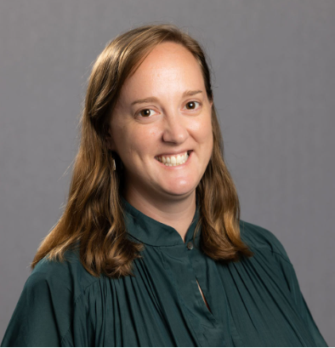
Dr Alice Fitzgerald
RG Kununurra, WA
“I work 2 days a week in private practice, one day a week as a medical educator for our rural medical students and the remainder of the time working for the local hospital which involves doing a mix of emergency, ward work, outreach clinics to remote communities and my procedural skill is obstetrics
“One day you are managing a multi-trauma and the next you are congratulating a young couple on their first positive pregnancy test. You get to be around for that couples’ pregnancy, delivery and get to know the baby as it starts to grow. I can’t think of many other jobs that provide such a range of cases.”

Slide 13
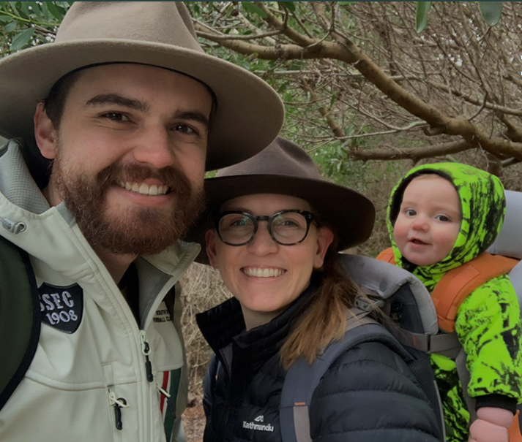
Dr Aaron Hawkins, RG, Deloraine, Tasmania
“ As a junior doctor I had been tossing up between psychiatry training, physician training and paediatrics, but then realised rural generalism could offer a small part of all of those without having to give any of it up. That realisation came at a time when my wife and I were feeling like a bit of an adventure, so we packed up and moved to Tasmania!
Once we settled in and were enjoying the lifestyle that living in the country can bring, we realised it was the right place for us. ”

Slide 14
How do I put in a submission?
Notes:
People living in rural and remote Australia receive $850 per capita per year in government health funding
This translates to $6.55b annual shortfall in spending on healthcare for these people (relative to that spent on people in major cities)
This reflects the fact that they receive fewer services than people in cities
Note: Specialist services figures source: AIHW. (2021). Medicare-subsidised GP, allied health and specialist health care across local areas: 2019–20 to 2020–21.
Note: 60% of rural hospitals do not have any FACEMS - Emergency physicians workforce figures source: ACEM Annual Census Report 2021

Slide 15
medboardconsultation@ahpra.gov.au
Public Consultation
Application for recognition of a new field of specialty practice:
Rural Generalist Medicine
Consultation closes: 12 December 2023
Notes:
RUTH TO TALK TO
Specialist field created under the National and added to the approved specialties list
AMC to accredit Fellowships as qualifications in specialist field (i.e. FACRRM and FRACGP-RG)
RGM is field within GP. Expected doctors with accredited qualification in this field would be both registered as specialist GP and RG
Doctors awarded approved qualification in the specialist field can apply for specialist registration. This is recorded in the register and they can use the title.

Slide 16
@RuralHC_Aus
@DrFayeMcMillan
@NowlanShelley
Thank you

